Slide 1
DP-600: Microsoft Fabric Analytics Engineer
Day 4
Notes:
Instructor notes and guidance.
This space has been left deliberately blank

Slide 2
Get started with Real-Time Intelligence with Microsoft Fabric
Notes:
https://aka.ms/fabric-real-time
Before delivering this presentation, review the associated module on Microsoft Learn.
The estimated time to present these slides is 30 minutes.

Slide 3
Learning objectives
Use basic syntax and of Kusto Query Language (KQL) and querysets.
Describe how to execute T-SQL queries in the Queryset canvas.
Copy, export, and share data results.
Notes:
Perhaps you've heard that Power BI can seamlessly handle trillions of rows of data, but you're not able to accomplish that in your own Power BI tenant. Working with high volume and large-scale data can be done in Fabric and Power BI with the right groundwork in place.
This module introduces considerations for building enterprise scale, IT-driven solutions. You'll review data modeling best practices and Power BI Premium/Fabric features for working with large data.

Slide 4
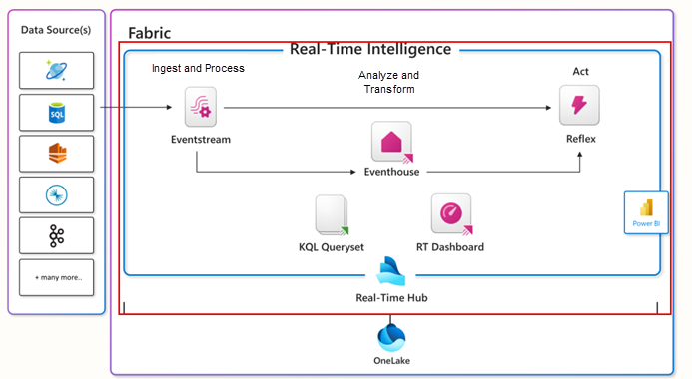
What is Real-Time Intelligence?
Notes:
Fabric's Real-Time Intelligence solution provides an end-to-end streaming solution for high-speed data analysis across the Fabric service. It’s optimized for time-series data and supports automatic partitioning and indexing of any data format.
Real-Time Intelligence delivers high performance for data of various sizes, ranging from a few gigabytes to several petabytes. It can handle data from different sources and in various formats. Fabric's Real-Time Intelligence workload can be used for solutions like IoT and log analytics in many scenarios including manufacturing, oil and gas, and automotive.
Understand Real-Time Intelligence in Microsoft Fabric
Real-Time Intelligence is a fully managed service that is optimized for streaming time-series data. With Real-Time Intelligence, you're able to get consistent performance searching all types of data at scale, including structured, unstructured, and semi-structured data. Additionally, it's integrated with the entire suite of Fabric capabilities, which allows a streamlined workflow from data loading to data visualization.
By Using Real-Time Intelligence in Fabric, you can:
Ingest data from any source, in any data format.
Run analytical queries directly on raw data without the need to build complex data models or create scripting to transform the data.
Import data with by-default streaming that provides high performance, low latency, high freshness data analysis.
Imported data undergoes default partitioning - both time and hash-based partitioning, and by-default indexing.
Work with versatile data structures and query structured, semi-structured, or free text.
Query raw data without transformation, with high performance, incredibly low response time, and using a wide variety of available operators.
Scale to an unlimited amount of data, from gigabytes to petabytes, with unlimited scale on concurrent queries and concurrent users.
Integrate seamlessly with other workloads and items in Microsoft Fabric.

Slide 5
What is the Kusto Query Language (KQL)
Data exploratory tool
Discover patterns
Identify anomalies and outlets
Create statistical modeling
KQL is case-sensitive for everything – table names, table column names, operators, functions, and so on.
Widespread use in Azure
Log queries in Azure Monitor
Microsoft Sentinel
Azure Data Explorer
Azure Real-Time Intelligence in Microsoft Fabric
Notes:
Kusto Query Language (KQL) is a declarative query language used to analyze and extract insights from structured, semi-structured, and unstructured data. KQL was designed specifically for searching large-scale log data efficiently and quickly, making it perfectly suited for cloud-based data analytics.
Consider the following benefits of the KQL capabilities in Microsoft Fabric:
It enables efficiency in data exploration and data analysis by allowing users to work with heterogeneous data sources and visualize the results in various ways.
It supports reproducible analyses by allowing users to create notebooks with Kusto kernel that can capture code, results, and context on the analysis.
It improves DevOps troubleshooting experience by allowing users to create runbooks or playbooks in notebooks with Kusto kernel that can detail how to troubleshoot and mitigate issues using telemetry data.
It enriches DevOps flow by allowing users to add KQL files and KQL notebook files to their Git repositories and CI/CD pipelines.
It provides guidance and helps you build search queries from scratch by using the KQL editor that quickly identifies potential errors and displays hints about how to resolve issues.
It lets you quickly paste long, complex queries directly into the editor if you receive them from other sources.
It allows you to filter, present, and aggregate your data using various operators and functions that are easy to read and author.

Slide 6
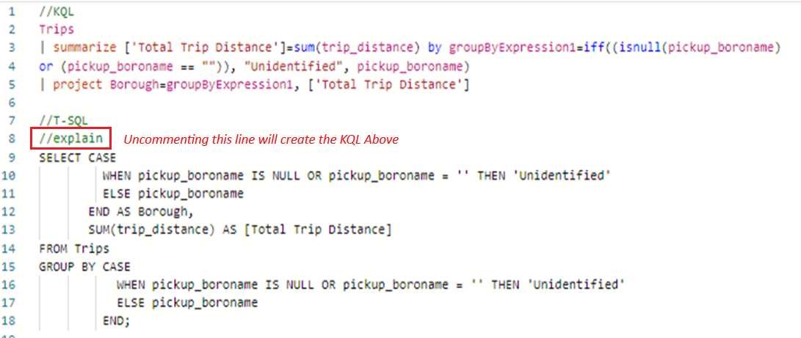
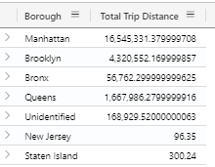
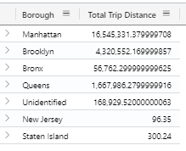
Use of KQL in Microsoft Fabric
KQL Queryset
KQL over T-SQL Advantages
T-SQL over KQL Advantages
NOTE: SQL can many times be converted to KQL by using the explain syntax in the front of the query.
KQL and SQL Querying showing same results
KQL
T-SQL
Notes:
Show that both T-SQL and KQL both have their strengths, and it boils down to using the right tool for the right job. When we’re querying distributed data that might be a mixture of structured and unstructured data then KQL might be better; however, there are many cases where when querying a OneLake or ingesting data from an external source, such as a blob storage, KQL may prove more worthy.
KQL Queryset
Basic stored queries
Functions and operators
Arithmetic, comparison, logical operations, string manipulation
Advanced queries
Aggregations, joins, and subqueries
Ability to export results
KQL over T-SQL Advantages
Simplicity
Performance
Flexibility
T-SQL over KQL Advantages
Compatibility
Functionality
Procedural programming
NOTE: SQL can many times be converted to KQL by using the explain syntax in the front of the query

Slide 7
Write KQL queries
// queries all data from StormEvents table
StormEvents
// understand how many rows are in the table by applying count
StormEvents
| count
// limit the results with take
StormEvents
| take 5
// be more specific with the data using the project
StormEvents
| take 5
| project State, EventType, DamageProperty
// look at the events by State and EventType
StormEvents
| where State == 'TEXAS' and EventType == 'Flood'
| project StartTime, EndTime, State, EventType, DamageProperty
// retrieve the top five Texas floods which caused the most damage StormEvents
| where State == 'TEXAS' and EventType == 'Flood'
| top 5 by DamageProperty
| project StartTime, EndTime, State, EventType, DamageProperty
Notes:
This is a build slide. Each click shows the next code example.
Kusto Query Language (KQL) is a declarative query language used to analyze and extract insights from structured, semi-structured, and unstructured data. KQL was designed specifically for searching large-scale log data efficiently and quickly, making it perfectly suited for cloud-based data analytics.
Consider the following benefits of the KQL capabilities in Microsoft Fabric:
It enables efficiency in data exploration and data analysis by allowing users to work with heterogeneous data sources and visualize the results in various ways.
It supports reproducible analyses by allowing users to create notebooks with Kusto kernel that can capture code, results, and context on the analysis.
It improves DevOps troubleshooting experience by allowing users to create runbooks or playbooks in notebooks with Kusto kernel that can detail how to troubleshoot and mitigate issues using telemetry data.
It enriches DevOps flow by allowing users to add KQL files and KQL notebook files to their Git repositories and CI/CD pipelines.
It provides guidance and helps you build search queries from scratch by using the KQL editor that quickly identifies potential errors and displays hints about how to resolve issues.
It lets you quickly paste long, complex queries directly into the editor if you receive them from other sources.
It allows you to filter, present, and aggregate your data using various operators and functions that are easy to read and author.

Slide 8
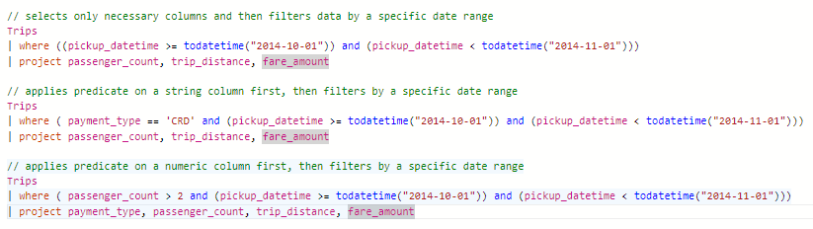
Best practices in SaaS and KQL
Reduce the amount of data
Use the right data types
Additional considerations
Notes:
As with any language, there are several best practices in Microsoft Fabric KQL that can improve query performance and prevent data quality issues viewed on the data consumer side. As this is a SaaS solution, additional tuning of the data and storage are optimized on the backend by Microsoft.
Reduce the amount of data:
Filter data by a specific date range
Apply predicates on string columns
Apply predicates on numeric columns
Use project to reduce unnecessary rows
Use the right data types:
Reduces unnecessary storage
Improves compression
Avoid redundant qualified references
Reference database-in-scope entities
Additional considerations
Use the where clause
Use the summarize operator for aggregations (count, sum, avg)
Avoid the use of wildcards (*, ?)

Slide 9
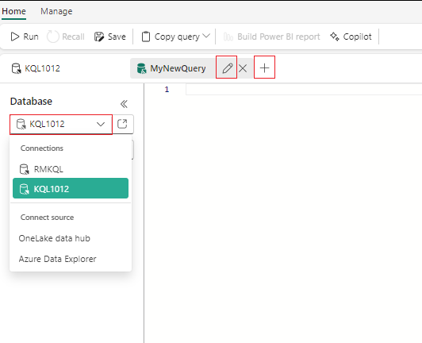
Manage queryset tabs
You have the ability with a KQL Queryset to create multiple tabs, with each associated with a different KQL database. This is very similar to a SQL Server connecting a query window to multiple databases.
You have the ability to rename the tab by selecting the pencil icon.
You can click on the + icon to create a new tab
Under Database you can change the database context by selecting the existing database connection which opens the data hub
Notes:
Within a KQL queryset, you can create multiple tabs. Each tab can be associated with a different KQL database, and lets you save queries for later use or share with others to collaborate on data exploration. You can also change the KQL database associated with any tab, allowing you to run the same query on data in different states.

Slide 10
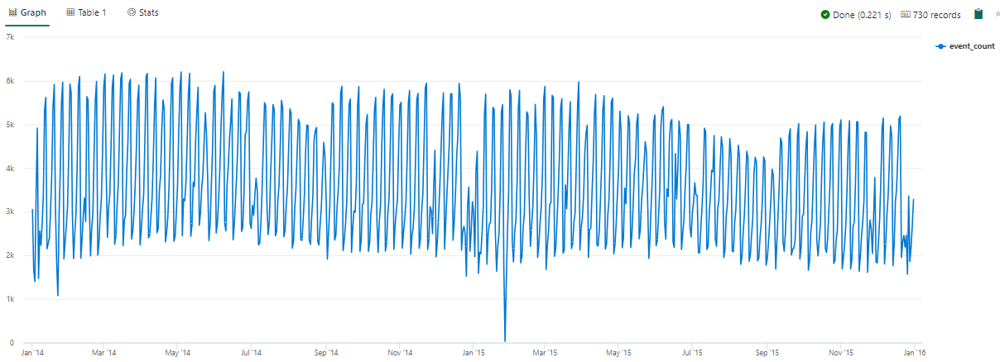
Visualize with KQL
Using render expressions in KQL
Trips
| summarize event_count=count() by bin(pickup_datetime, id)
| render timechart
Notes:
Express the simplicity of being able to view both the table and in many cases a visualization of the results using the render capability.

Slide 11
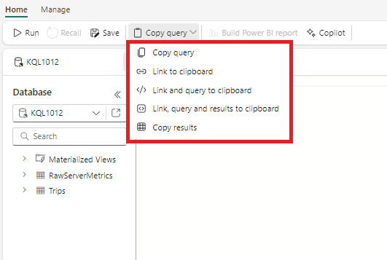
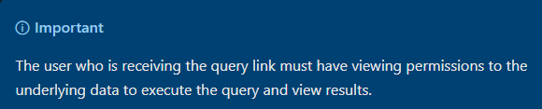
Copy and share data
Below is an explanation of the options for copying and sharing a query:
Copy query: simply copies the text of the query
Link to clipboard: copies the deep link that can be used to run the query
Link and query to clipboard: copies the link that can be used for running the query and the text of the query
Link, query and results to the clipboard: copy a link that can be used to run the query, its text, and the results
Copy results: copy the results of the query execution
Notes:
Within a KQL queryset, you can create multiple tabs. Each tab can be associated with a different KQL database, and lets you save queries for later use or share with others to collaborate on data exploration. You can also change the KQL database associated with any tab, allowing you to run the same query on data in different states.

Slide 12
Exercise
Get started with Real-Time Intelligence in Microsoft Fabric
30 minutes
Notes:
https://aka.ms/mslearn-fabric-real-time

Slide 13
Knowledge check
1
Which expression allows you to convert most T-SQL queries to KQL?
take
project
explain
2
Which KQL query would give me a total count of the Trips table
Trips | count
trips | count(*)
trips | count
3
When query table names, table column names, operators, functions, and so on, KQL is?
Case-sensitive on functions and operators but case-insensitive for tables and column names.
Case-insensitive
Case-sensitive
Notes:
Allow students a few minutes to think about the questions, and then use the animated slide to reveal the correct answers.

Slide 14
Recap
In this section, we learned:
KQL syntax and KQL database navigation.
How to use T-SQL and convert to KQL.
Best practices with KQL in Fabric.

Slide 15

Further reading
Get started with Real-Time Intelligence in Microsoft Fabric
https://aka.ms/fabric-real-time
Query data in a KQL database in Microsoft Fabric
https://aka.ms/fabric-query-kql
Notes:
Encourage students to review the online material on Microsoft Learn on which this presentation is based.

Slide 16
Secure data access in Microsoft Fabric
Notes:
https://aka.ms/fabric-secure-data
Before delivering this presentation, review the associated module on Microsoft Learn.
The estimated time to present these slides is 45 minutes.

Slide 17
Learning objectives
Understand Fabric security model
Configure workspace and item permissions
Apply granular permissions
Notes:
Perhaps you've heard that Power BI can seamlessly handle trillions of rows of data, but you're not able to accomplish that in your own Power BI tenant. Working with high volume and large-scale data can be done in Fabric and Power BI with the right groundwork in place.
This module introduces considerations for building enterprise scale, IT-driven solutions. You'll review data modeling best practices and Power BI Premium/Fabric features for working with large data.

Slide 18
Secure data by workload and job responsibilities
Data engineers
Business or data analysts
Data scientists
Report creators
Report consumers
Notes:
Security in Microsoft Fabric is optimized for securing data for specific use cases. Different users need the ability to perform various actions in Fabric to fulfill their job responsibilities. Fabric facilitates this by allowing you to grant users access to specific data workloads through workspace and item permissions, compute permissions, and OneLake data access roles.
Secure data by use case
A security use case in Fabric refers to a set of users needing data access and accessing data in a specific way. Once a use case is identified, Fabric permissions associated with that use case can be configured. Suppose you work at a healthcare company with multiple systems that store data, such as electronic health records (EHR), insurance claims data, clinical trial data, patient and disease registries, and administrative data. Different users within your company or partner organizations need to view, transform, analyze, aggregate, and use this data to derive business insights. Users need access to different Fabric compute engines, items, and workspaces to perform their jobs effectively:
Data engineers - need access to data in a lakehouse to develop downstream data products.
Business or data analysts - need to query data to answer business questions.
Data scientists - need to access data in a lakehouse and consume it through Apache Spark to create models and experiments.
Report creators - need to build reports to share with report consumers.
Report consumers - need to view data in Power BI reports to make decisions.
In this module, you'll learn how to use the Fabric access control features available to secure your data and provide your team with the necessary access within Fabric to perform their job duties. You'll explore Fabric’s multi-layer security model and how to use it to manage data access.
By the end of this module, you'll know how to configure security for an entire workspace, for individual Fabric data items, and how to apply granular permissions within Fabric data items.

Slide 19


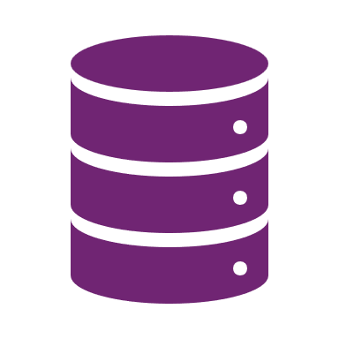
Understand the Fabric security model
Sequential access evaluation
Microsoft Entra ID authentication: checks if the user can authenticate to the Azure identity and access management service, Microsoft Entra ID.
Fabric access: checks if the user can access Fabric..
Data security: checks if the user can perform the action they've requested on a table or file.
Notes:
Data access in organizations is often restricted by users' responsibilities, and roles and by an organization's Fabric deployment patterns, and data architecture. Fabric has a flexible, multi-layer security model that allows you to configure security to accommodate different data access requirements. Having the ability to control permissions at different layers means you can adhere to the principle of least privilege, restricting user permissions to only what's needed to perform job tasks.
Fabric has three security levels and they're evaluated sequentially to determine whether a user has data access. The order of evaluation for access is:
1. Microsoft Entra ID authentication: checks if the user can authenticate to the Azure identity and access management service, Microsoft Entra ID.
2. Fabric access: checks if the user can access Fabric.
3. Data security: checks if the user can perform the action they've requested on a table or file.

Slide 20
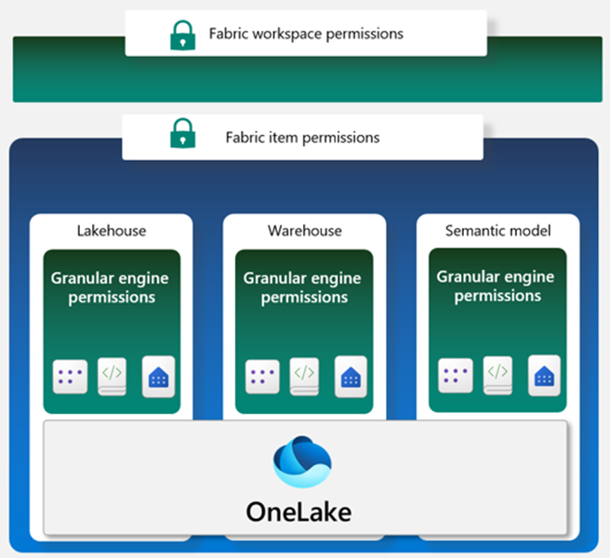
Data security design
Workspace roles
Item permissions
Compute or granular permissions
OneLake data access controls
Notes:
The third Fabric security level, data security, has several building blocks that can be configured individually or together to align with different access requirements. The primary access controls in Fabric are:
- Workspace roles
- Item permissions
- Compute or granular permissions
- OneLake data access controls (preview)
It's helpful to envision these building blocks in a hierarchy to understand how access controls can be applied individually or together. (See the image at the right)
A *workspace* in Fabric enables you to distribute ownership and access policies using *workspace roles*. Within a workspace, you can create Fabric data *items* like lakehouses, data warehouses, and semantic models. *Item permissions* can be inherited from a workspace role or set individually by sharing an item. Items are shared using item permissions when workspace roles are too permissive.
Within each data item, *granular engine permissions* such as Read, ReadData, or ReadAll can be applied.
Compute or granular permissions can be applied within a specific compute engine in Fabric, like the SQL Endpoint or semantic model.
Fabric data items store their data in OneLake. Access to data in the lakehouse can be restricted to specific files or folders using the role-based-access control (RBAC) feature called *OneLake data access controls (preview)*.

Slide 21
Understand workspace roles
Admin
Member
Contributor
Viewer
Notes:
Workspaces are environments where users can collaborate to create groups of items. Items are the resources you can work with in Fabric such as lakehouses, warehouses, and reports. Workspace roles are preconfigured sets of permissions that let you manage what users can do and access in a Fabric workspace.
Item permissions control access to individual Fabric items within a workspace. Item permissions let you either adjust the permissions set by a workspace role or give a user access to one or more items within a workspace without adding the user to a workspace role.
Let's consider some scenarios where you would need to configure data access using workspace roles and item permissions.
Understand workspace roles
Suppose you work at a health care company as the Fabric security admin. You need to set up access for a new data engineer. The data engineer needs the ability to:
- Create Fabric items in an existing workspace
- Read all data in an existing lakehouse that's in the same workspace where they can create Fabric items
Workspace roles control what users can do and access within a Fabric workspace. There are four workspace roles and they apply to *all items* within a workspace. Workspace roles can be assigned to individuals, security groups, Microsoft 365 groups, and distribution lists. Users can be assigned to the following roles:
Admin- Can view, modify, share, and manage all content and data in the workspace, and manage permissions.
Member - Can view, modify, and share all content and data in the workspace.
Contributor - Can view and modify all content and data in the workspace.
Viewer - Can view all content and data in the workspace, but can't modify it.
To meet the access requirements for the new data engineer, you can assign them the workspace Contributor role. This gives them access to modify content in the workspace, including creating Fabric items like lakehouses. The contributor role would also allow them to read data in the existing lakehouse.

Slide 22
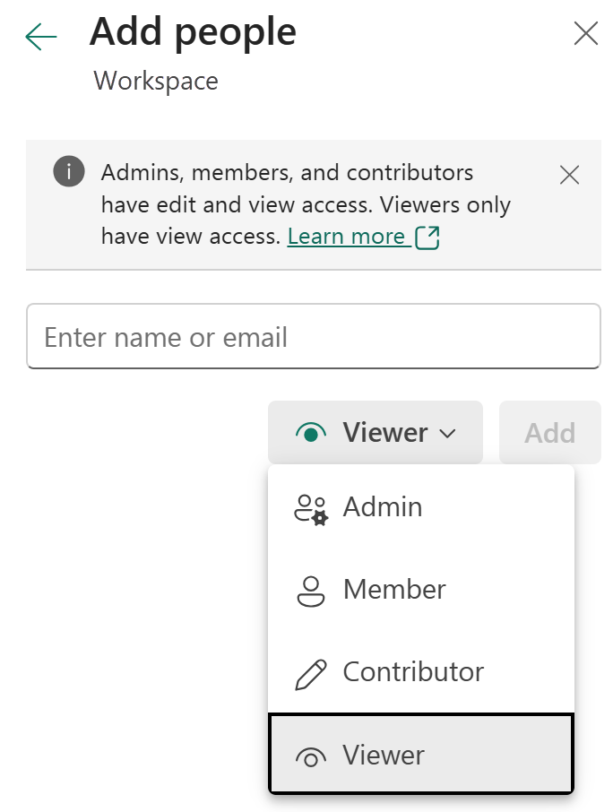
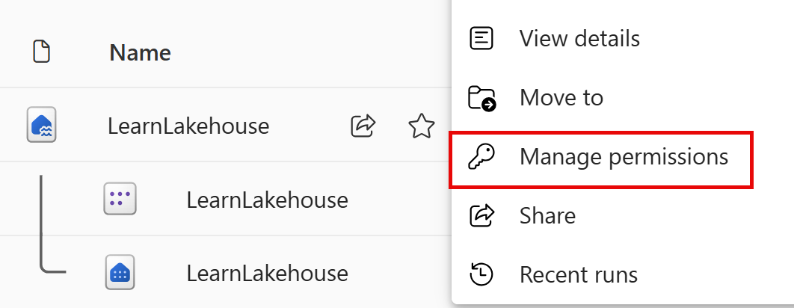
Configure workspace and item-level permissions
Workspace access
Item-level permissions
Notes:
Manage workspace access
Users can be added to workspace roles from the Manage access button from within a workspace. Add a user by entering the user's name and selecting the workspace role to assign them in the Add people dialogue that appears after selecting Manage access.
Suppose that after a few months of having Contributor access on a workspace, a data engineer no longer needs to create Fabric items and now only needs to view a single lakehouse and read data in it.
Since the engineer no longer needs to view all items in the workspace, the Contributor workspace role can be removed and item permissions on the lakehouse can be configured so the engineer will only be able to see the lakehouse metadata and data and nothing else in the workspace. This item access configuration helps you adhere to the principle of least privilege, where the engineer only has access to what's needed to perform their job duties.
Item-level permissions
Item permissions control access to individual Fabric items within a workspace. Item permission can be used to give a user access to one or more items within a workspace without adding the user to a workspace role or can be used with workspace roles.
An item can be shared, and item permissions can be configured by selecting on the ellipsis (...) next to a Fabric item in a workspace and then selecting Manage permissions, as shown in the image.

Slide 23
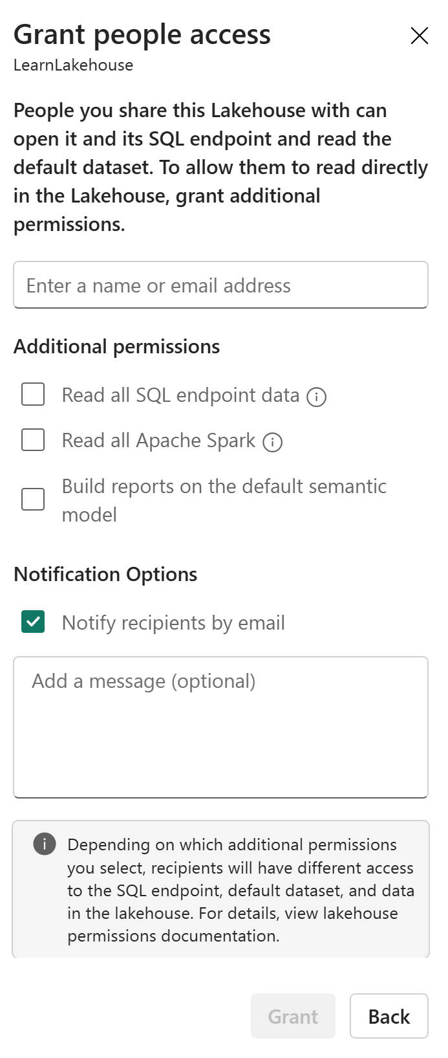
Configure lakehouse read access
Control by responsibility
SQL endpoint to query table data.
Apache Spark to access files.
Default semantic model to create Power BI reports.
Notes:
When the permissions provided by workspace roles or item permissions are insufficient, granular permissions like table and row-level security and file and folder access can be set through the:
SQL analytics endpoint
OneLake data access roles (preview)
Warehouse
Semantic model
Configure data access through the SQL analytics endpoint in a lakehouse
Data in a lakehouse can be read through the SQL analytics endpoint. Each Lakehouse has an autogenerated SQL analytics endpoint that can be used to transition between the *lake* view of the lakehouse and the *SQL* view of the lakehouse. The *lake* view supports data engineering and Apache Spark and the *SQL* view of the same lakehouse allows you to create views, functions, stored procedures and to apply SQL security and object level permissions.
Data in a Fabric lakehouse is stored with the following folder structure:
- /Files
- /Tables
The SQL analytics endpoint is used to read data in the /Tables folder of the lakehouse using T-SQL.

Slide 24
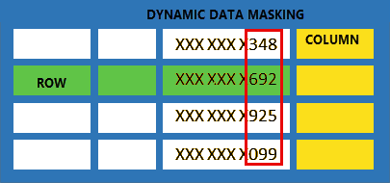
Use T-SQL to configure granular permissions
Control access to objects:
GRANT
DENY
REVOKE
Configure table-level access:
Row-level security
Column-level security
Dynamic data masking
Notes:
We’ve covered how you can manage access to workspaces, items such as a lakehouse, different types of access to the lakehouse. These all control the workspace and the entire lakehouse, but you might want to control access even further. This is where you can use T-SQL to grant granular permissions within the lakehouse, such as tables that contain PII (Personally Identifiable Information. Consider a scenario where you have a Patient table that you’ve limited access to with DCL.
Column-level security can prevent business analysts from viewing the SSN column.
Row-level security can ensure that patients can only view their own data.
Dynamic data masking can limit what is shown in the column, such as only the last 3 of the SSN.
Using the SQL analytics endpoint, granular T-SQL permissions can be applied to SQL objects using Data Control Language (DCL) commands such as:
GRANT
DENY
REVOKE
This can control access to tables or views, for example. To control access within the tables, you can use row-level and column-level security. Dynamic data masking can also be used to obfuscate the data within the results.

Slide 25
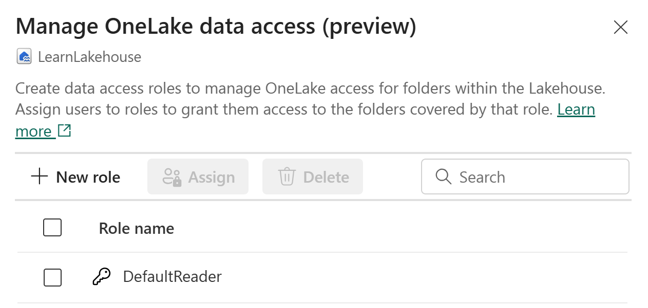
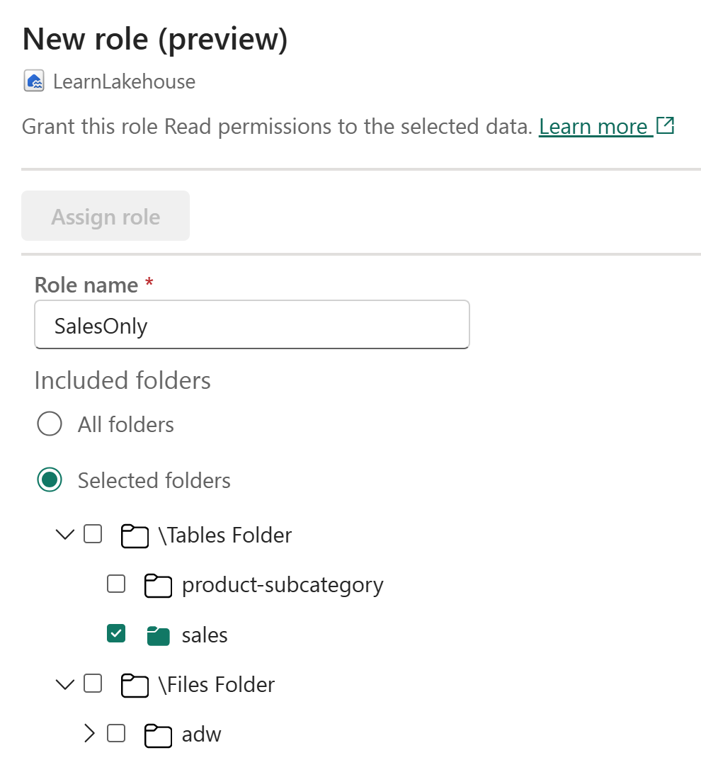
Use OneLake data access roles to secure data
Control access to folders and files within the lakehouse.
Create custom roles to grant access to specific folders.
Notes:
The lake view of the lakehouse is used to read data in the /Tables and /Files folder of the lakehouse.
Workspace and item permissions provide coarse access to data in a lakehouse. To further refine data access, folders in the lake view of the lakehouse can be secured using OneLake data access roles (preview). You can create custom roles within a lakehouse and grant read permissions only to specific folders in OneLake. Folder security is inheritable to all subfolders. To create a custom OneLake data access role:
1. Select Manage OneLake data access (preview) from the menu in the lake view of the lakehouse.
2. In the New Role window that will appear, create a new role name and select the folders to grant access to.
3. Once the role is created, assign a user or group to the role and select the permissions to assign.
For more information on how OneLake RBAC permissions are evaluated with workspace and item permissions, see: Data Access Control Model in OneLake (Public Preview) - Microsoft Fabric | Microsoft Learn

Slide 26
Exercise
Secure data access in Microsoft Fabric
45 minutes
Notes:
https://aka.ms/mslearn-fabric-secure-data

Slide 27
Knowledge check
1
What workspace role should be assigned to a data engineer who needs to create Fabric items and read all data in an existing lakehouse?
Viewer
Contributor
Admin
2
What is order of evaluation of access in Fabric?
Data security, Fabric access, Microsoft Entra ID authentication
Microsoft Entra ID authentication, Fabric access, Data security
Fabric access, Microsoft Entra ID authentication, Data security
Which of the following tools can be used to apply granular data access permissions in Fabric?
3
OneLake data access roles
Data Manipulation Language (DML)
Column-level security in the semantic model
Notes:
Allow students a few minutes to think about the questions, and then use the animated slide to reveal the correct answers.
What is order of evaluation of access in Fabric?
Incorrect Data security, Fabric access, Microsoft Entra ID authentication
Explanation: The order starts with Microsoft Entra ID authentication, not Data security.
Correct: Microsoft Entra ID authentication, Fabric access, Data security
Explanation: The order of evaluation for access in Fabric is Microsoft Entra ID authentication, Fabric access, and then Data security.
Incorrect: Fabric access, Microsoft Entra ID authentication, Data security
Explanation: The order starts with Microsoft Entra ID authentication, not Fabric access.
Which of the following tools can be used to apply granular data access permissions in Fabric?
Correct: OneLake data access roles
Explanation: OneLake data access roles allow you to create custom roles within a lakehouse and grant read access to specific folders.
Incorrect: Data Manipulation Language (DML)
Explanation: Data Control language (DCL) is used to provide granular T-SQL permissions. DML is used to manipulate data.
Incorrect: Column-level security in the semantic model
Explanation: There isn't column-level security in the semantic model.

Slide 28
Recap
In this section, we learned:
Access control features in Fabric
Data access management with multi-layer security
Workspace and individual data item security configurations
Apply granular permissions

Slide 29
Further reading
Secure data in Microsoft Fabric
https://aka.ms/fabric-secure-data
Notes:
Encourage students to review the online material on Microsoft Learn on which this presentation is based.

Slide 30
Administer Microsoft Fabric
Notes:
https://aka.ms/fabric-admin
Before delivering this presentation, review the associated module on Microsoft Learn.
The estimated time to present these slides is 45 minutes.

Slide 31
Learning objectives
Describe Fabric admin tasks
Navigate the admin center
Manage user access
Notes:
Administering Fabric involves a range of tasks that are essential for ensuring the efficient and effective use of the Fabric platform within an organization. As a Fabric administrator (admin), you need to have a solid understanding of the Fabric architecture, security and governance features, analytics capabilities, and various deployment and licensing options available. You also need to be familiar with the Fabric admin portal and other administrative tools, and be able to configure and manage the Fabric environment to meet the needs of your organization.

Slide 32
Understand the Fabric Architecture
Microsoft Fabric is an all-in-one analytics solution for enterprises that covers everything from data movement to data science, real-time intelligence, and business intelligence.
Data warehousing
Data engineering
Data integration
Data science
Real-time intelligence
Business intelligence
Notes:
As we learned in the Fabric introduction, Microsoft Fabric is an all-in-one analytics solution for enterprises that covers everything from data movement to data science, real-time intelligence, and business intelligence. It offers a comprehensive suite of services, including data lake, data engineering, and data integration, all in one place. With Fabric, you don’t need to piece together different services from multiple vendors. Instead, you can enjoy a highly integrated, end-to-end, and easy-to-use product that is designed to simplify your analytics needs¹.
Microsoft Fabric is built on a foundation of Software as a Service (SaaS), which takes simplicity and integration to a whole new level. It brings together new and existing components from Power BI, Azure Synapse, and Azure Data Factory into a single integrated environment. These components are then presented in various customized user experiences tailored to different roles and tasks¹.
Microsoft Fabric allows you to unify your data estate, manage powerful AI models, empower everyone in your business, and govern data across your organization. It also enables you to innovate faster by helping every person in your organization act on insights from within Microsoft 365 apps, such as Microsoft Excel and Microsoft Teams².

Slide 33





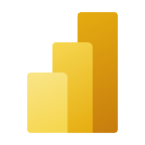

Understand Fabric architecture
Single SaaS lake
Provisioned automatically with the tenant
All workloads automatically store data in OneLake workspace folders
All data is organized in a hierarchical namespace
Data in OneLake is automatically indexed for discovery, MIP labels, lineage, PII scans, sharing, governance and compliance
Data
Factory
Data
Engineering
Data
Science
Data Warehouse
Real-time Intelligence
Power BI
OneLake
Finance
Customer 360
Service telemetry
Business
KPIs
Warehouse
Lakehouse
Lakehouse
Warehouse
Workspace A
Workspace B
Intelligent data foundation
Notes:
The image shows the Fabric components, with OneLake as the foundation, and each experience built on top.
All of the Fabric experiences use OneLake as their native store without needing any additional configuration. OneLake is hierarchical in nature to simplify management across your organization. There's only one OneLake per tenant and it provides a single-pane-of-glass file-system namespace that spans across users, regions and even clouds. The data in OneLake is divided into manageable containers for easy handling. If we actually look at how this data is stored in OneLake, you are not going to see data items and workspaces. You will see files and folders just like you would in a data lake today. All workspaces are folders, each data item will be a folder. Any tabular data is stored in delta lake format. There are no new proprietary file formats for Fabric. Proprietary formats create data silos. Even the data warehouse natively stores its data in delta lake format. While Fabric data items will standardize on delta for tabular data, OneLake is still a data lake built on top of ADLS gen2. It will support any file type, structured or unstructured.

Slide 34

Understand Fabric concepts
Wide World Importers
Organizational tenant
Marketing capacity
Tenant
Capacity
Domain
Workspace
Items
Product workspace
Pricing workspace
People workspace
Sales capacity
Enterprise workspace
Direct sales workspace
Finance capacity
Admin workspace
Budgeting workspace
Planning workspace
Notes:
A Fabric tenant is a dedicated space for organizations to create, store, and manage Fabric items. There's often a single instance of Fabric for an organization, and it's aligned with Azure Active Directory. The Fabric tenant maps to the root of OneLake and is at the top level of the hierarchy.
Capacity is a dedicated set of resources that is available at a given time to be used. A tenant can have one or more capacities associated with it. Capacity defines the ability of a resource to perform an activity or to produce output. Different items consume different capacity at a certain time. Fabric offers capacity through the Fabric SKU and Trials.
A domain is a logical grouping of workspaces. Domains are used to organize items in a way that makes sense for your organization. You can group things together in a way that makes it easier for the right people to have access to the right workspaces. For example, you might have a domain for sales, another for marketing, and another for finance.
A workspace is a collection of items that brings together different functionality in a single tenant. It acts as a container that leverages capacity for the work that is executed, and provides controls for who can access the items in it. For example, in a sales workspace, users associated with the sales organization can create a data warehouse, run notebooks, create datasets, create reports, etc.
Fabric items are the building blocks of the Fabric platform. They're the objects that you create and manage in Fabric. There are different types of items, such as data warehouses, data pipelines, datasets, reports, and dashboards.
Understanding Fabric concepts is important for you as an admin, because it helps you understand how to manage the Fabric environment.
[!NOTE] See Enable Microsoft Fabric for your organization to learn how to opt in to the Fabric public preview.

Slide 35
Fabric admin tasks
Security and access control
Data governance
Customization and configuration
Monitoring and optimization
Notes:
As an admin, you may be responsible for a wide range of tasks to keep the Fabric platform running smoothly. These tasks include:
Security and access control: One of the most important aspects of Fabric administration is managing security and access control to ensure that only authorized users can access sensitive data. You can use role-based access control (RBAC) to define who can view and edit content, set up data gateways to securely connect to on-premises data sources, and use Azure Active Directory (Azure AD) to manage user access.
Data governance: Effective Fabric administration requires a solid understanding of data governance principles. You should know how to secure inbound and outbound connectivity in your tenant and how to monitor usage and performance metrics. You should also know how to apply data governance policies to ensure data within your tenant is only accessible to authorized users.
Customization and configuration: Fabric administration also involves customizing and configuring the platform to meet the needs of your organization. This could include configuring private links to secure your tenant, defining data classification policies, and adjusting the look and feel of reports and dashboards.
Monitoring and optimization: As a Fabric admin, you need to know how to monitor the performance and usage of the platform, optimize resources, and troubleshoot issues. This includes configuring monitoring and alerting settings, optimizing query performance, managing capacity and scaling, and troubleshooting data refresh and connectivity issues.
Specific tasks may vary depending on the needs of your organization and the complexity of your Fabric implementation.

Slide 36
Fabric admin tools
Fabric admin portal
PowerShell cmdlets
Admin APIs and SDKs
Admin monitoring workspace
Fabric capacity metrics app
Notes:
You need to familiarize yourself with a few tools to effectively implement the tasks outlined above. Fabric admins can perform most admin tasks using one or more of the following tools: the Fabric admin portal, PowerShell cmdlets, admin APIs and SDKs, the admin monitoring workspace, and the capacity monitoring app.
As an analytics engineer, you may not need to use these tools, and in fact you may not have access to many of them. We’re going to cover the admin portal, the admin monitoring workspace, and the capacity metrics app in more detail, as these are items you may want to be aware of.

Slide 37
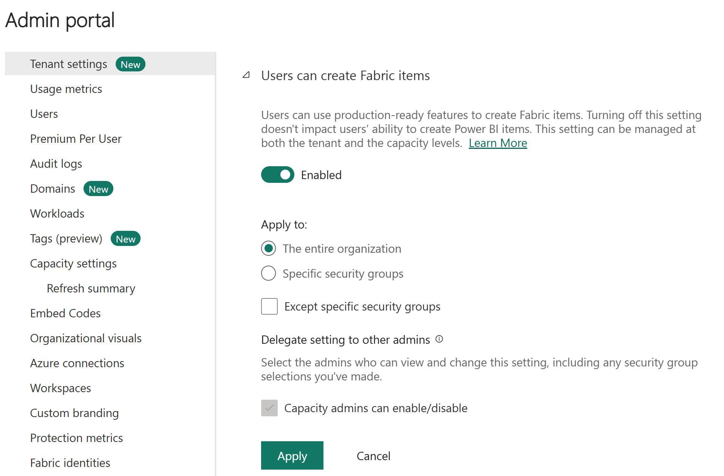
Fabric admin portal
Centrally manage, review, and apply settings for the entire tenant or by capacity.
Notes:
This is a build slide
Fabric's admin portal is a web-based portal where you can manage all aspects of the platform. In the admin portal you can centrally manage, review, and apply settings for the entire tenant or by capacity. You can also manage users, admins and groups, access audit logs, and monitor usage and performance. It’s important to familiarize yourself with the features that can be controlled in the admin portal, even if you’re not an admin, so that you know exactly what to ask for. For example, if you need to be able to publish a Power BI report to the web, or write to a semantic model using the XMLA endpoint.
Access to the admin portal requires a Fabric license, and the portal is accessible to admins with roles such as Global administrator, Power Platform administrator, and Fabric administrator. Click
There's one setting that we'd like to call out which may change how you and your users experience Fabric. The Fabric on/off switch, located in tenant settings lets organizations that use Power BI opt into Fabric. Here, you can enable Fabric for your tenant or allow capacity admins to enable Fabric.

Slide 38
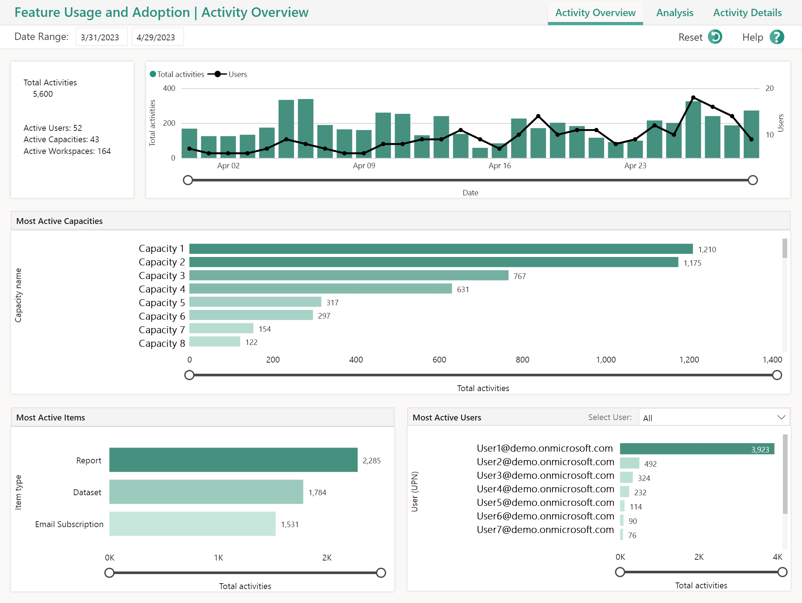
Fabric admin monitoring workspace
Monitor your environment including:
capacities
workspaces
items
activities
users
Notes:
Fabric tenant admins have access to the new admin monitoring workspace. You can choose to share access to the admin monitoring workspace or specific items within it with other users in your organization.
The admin monitoring workspace includes the Feature Usage and Adoption dataset and report, which together provide insights on the usage and performance of your Fabric environment. You can use this information to identify trends and patterns, and troubleshoot issues. Understanding the admin monitoring workspace equips you with essential tools for effective administration, security, and governance within the Fabric environment.

Slide 39
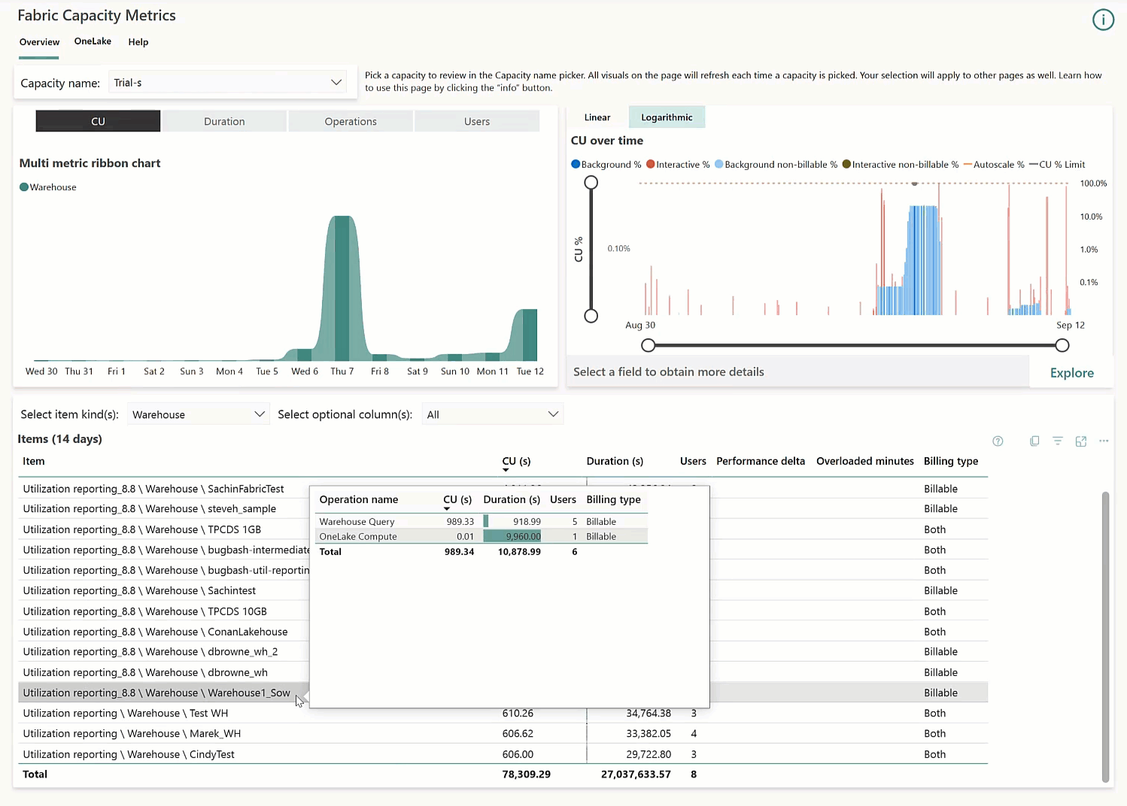
Fabric capacity metrics app
Charts display capacity usage over a 14-day period
Helps you understand which workloads use more capacity
Notes:
You must be a capacity admin to install and view the Microsoft Fabric Capacity Metrics app. This may be an opportunity for you to work with your admin (if that is not you), to understand what’s going on in your Fabric tenant. The Microsoft Fabric Capacity Metrics app is designed to provide monitoring capabilities for Microsoft Fabric capacities. Monitoring your capacities is essential for making informed decisions on how to best use your capacity resources. For example, the app can help identify when to scale up your capacity or when to turn on autoscale. The app shows how much compute is used by each workload type and helps admins identify inefficiencies in capacity usage.
Read more at: aka.ms/FabricCapacityMetrics

Slide 40

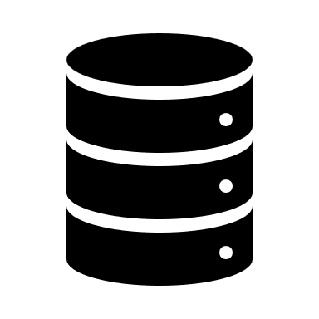






Manage Fabric security
Network control & security
Workspace & item access control
Data security access control
Your data in Fabric
Regulations & Certification
Data Encryption
E2E Auditability
High Availability & Disaster Recovery
Microsoft Information Protection
Microsoft Purview
Your user
Your storage accounts
Secured inbound Connectivity
Secured outbound Connectivity
Notes:
Microsoft Fabric security is based on Power BI security. Your role as an admin is to manage security for the Fabric environment, including managing users and groups, and managing how users interact with Fabric in terms of sharing and distribution of content.
List of the security features available in Microsoft Fabric.
Conditional access - Secure your apps using Azure Active Directory (Azure AD).
Resiliency - Reliability and regional resiliency with Azure availability zones.
Lockbox - Control how Microsoft engineers access your data.
Service tags - Enable an Azure SQL Managed Instance (MI) to allow incoming connections from Microsoft Fabric.
OneLake security - Learn how to secure your data in OneLake.

Slide 41
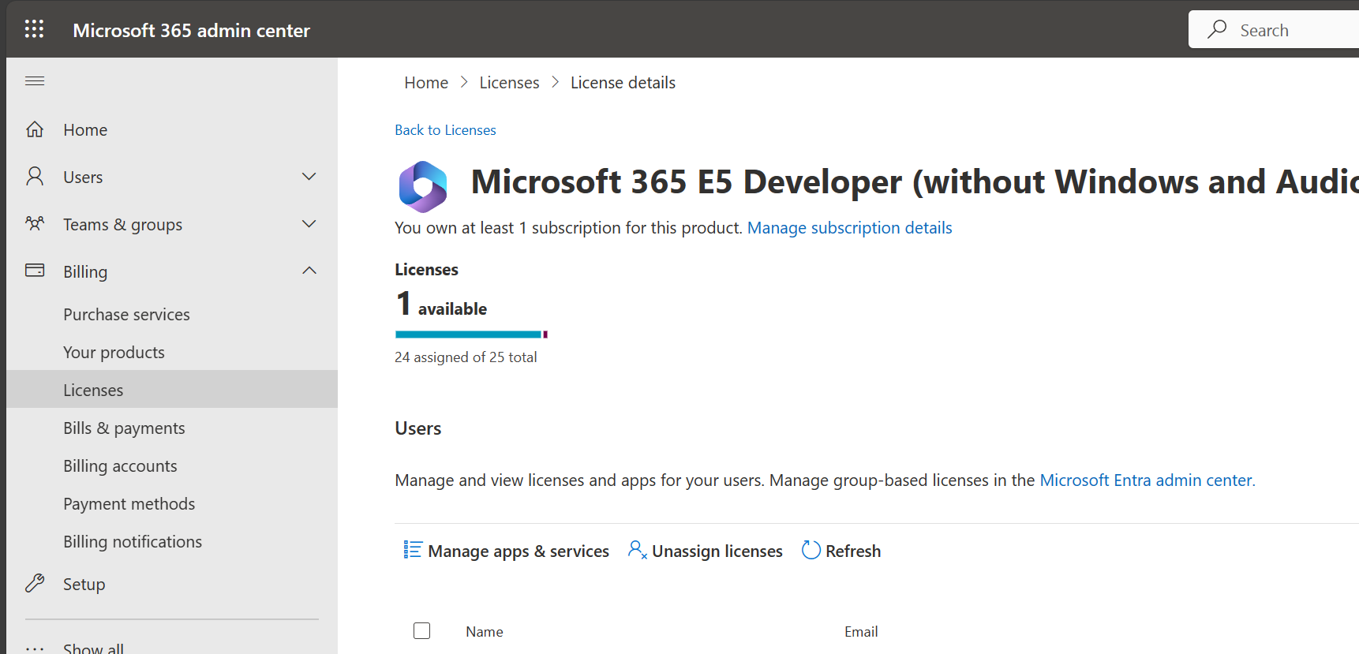
Assign and manage user licenses
Control the level of access and functionality in Fabric.
License management for Fabric is in the M365 admin center.
The next step beyond licenses is workspace management.
Notes:
Licenses control the level of access and functionality that users have within the Fabric environment. Administrators can ensure that licensed users have the necessary access to data and analytics to perform their roles effectively, while also limiting access to sensitive data and ensuring compliance with data protection laws and regulations.
Managing licenses allows administrators to monitor and control costs by ensuring that licenses are allocated efficiently and only to users who need them. This can help to prevent unnecessary expenses and ensure that the organization is utilizing its resources effectively.
Having the appropriate procedures in place to assign and manage licenses helps to control access to data and analytics, ensure compliance with regulations, and optimize costs.
License management for Fabric is handled in the Microsoft 365 admin center. For more information about managing licenses, see Assign licenses to users.

Slide 42
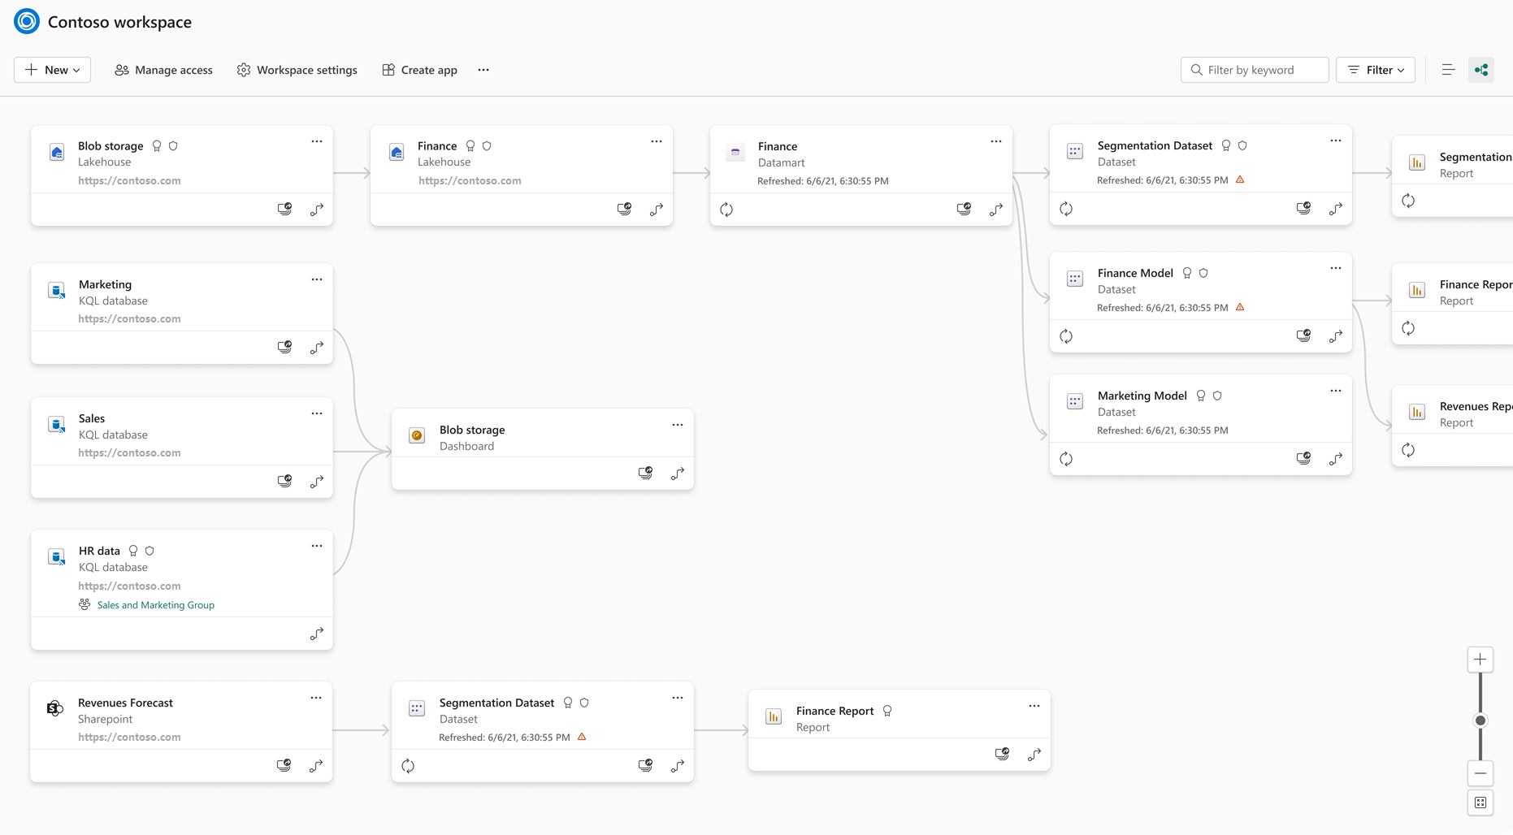
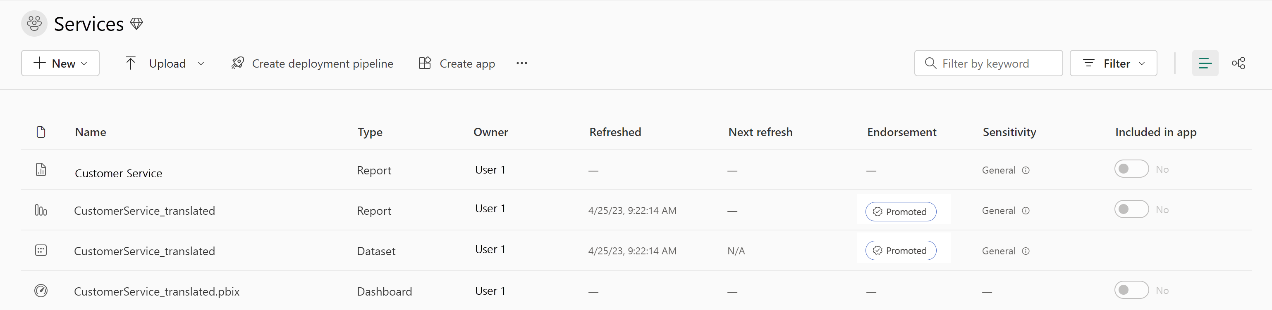
Govern data in Fabric
Endorse Fabric content
Track data lineage
Run metadata scanning
Name of the item
Owner's name
Sensitivity label
Endorsement status
Semantic Models in Power BI:
Names of tables
Names of columns
Defined measures
DAX formulas
Queries for mashup
Notes:
This is a build slide Fabric has a few built-in governance features to help you manage and control your data. Endorsement is a way for you as an admin to designate specific Fabric items as trusted and approved for use across the organization. Admins can also make use of the scanner API to scan Fabric items for sensitive data, and the data lineage feature to track the flow of data through Fabric.
Content endorsement
Content endorsement is an essential governance feature that helps you establish trust in your data assets by promoting and certifying specific Fabric items as trusted and approved for use across the organization. All Fabric items can be endorsed except dashboards. Promoted Fabric content appears with a Promoted badge in the Fabric portal. Workspace members with the contributor or admin role can promote content within a workspace. The Fabric admin can promote content across the organization. Endorsed assets are identified with a badge that indicates they have been reviewed and approved. Endorsement helps your users know which assets they can trust and rely on for accurate information, and it also helps you as an admin manage the overall growth of items across your environment.
Content certification is a more formal process that involves a review of the content by a designated reviewer. Certified Fabric content appears with a Certified badge in the Fabric portal. The certification process is managed by you, the admin, and can be customized to meet the needs of your organization.
If you aren't an admin, you need to request item certification from an admin. You can do request certification by selecting the item in the Fabric portal, and then selecting Request certification from the More menu.
< Click >
Data lineage tracking
Data lineage is the ability to track the flow of data through Fabric. Data lineage allows you to see where data comes from, how it's transformed, and where it goes. This helps you understand the data that is available in Fabric, and how it's being used.
< Click >
Metadata scanning
Metadata scanning facilitates governance of data by enabling cataloging and reporting on all the metadata of your organization's Fabric items. The scanner API is a set of Admin REST APIs that allows you to scan Fabric items for sensitive data. Use the scanner API to scan data warehouses, data pipelines, datasets, reports, and dashboards for sensitive data. The scanner API can be used to scan both structured and unstructured data. Before metadata scanning can be run, it needs to be set up in your organization by an Admin.

Slide 43
Knowledge check
1
Which of the following statements best describes the concept of capacity in Fabric?
Capacity refers to a dedicated space for organizations to create, store, and manage Fabric items.
Capacity defines the ability of a resource to perform an activity or to produce output.
Capacity is a collection of items that are logically grouped together.
2
Which of the following statements is true about the difference between promotion and certification in Fabric?
Promotion and certification both allow any workspace member to endorse content.
Promotion requires a higher level of permissions than certification.
Certification must be enabled in the tenant by the admin, while promotion can be done by a workspace member.
Notes:
Allow students a few minutes to think about the questions, and then use the animated slide to reveal the correct answers.

Slide 44
Recap
In this section, we:
Understand data teams and roles that use Fabric.
Fabric admin center and admin tasks.
Manage user access.
Data governance in Fabric.

Slide 45
Further reading
Administer Microsoft Fabric
https://aka.ms/fabric-admin
Enable Microsoft Fabric for your organization
https://aka.ms/FabricSwitch
Use the Microsoft Fabric Capacity Metrics App
https://aka.ms/FabricCapacityMetrics
Notes:
Encourage students to review the online material on Microsoft Learn on which this presentation is based.

